Slide 1
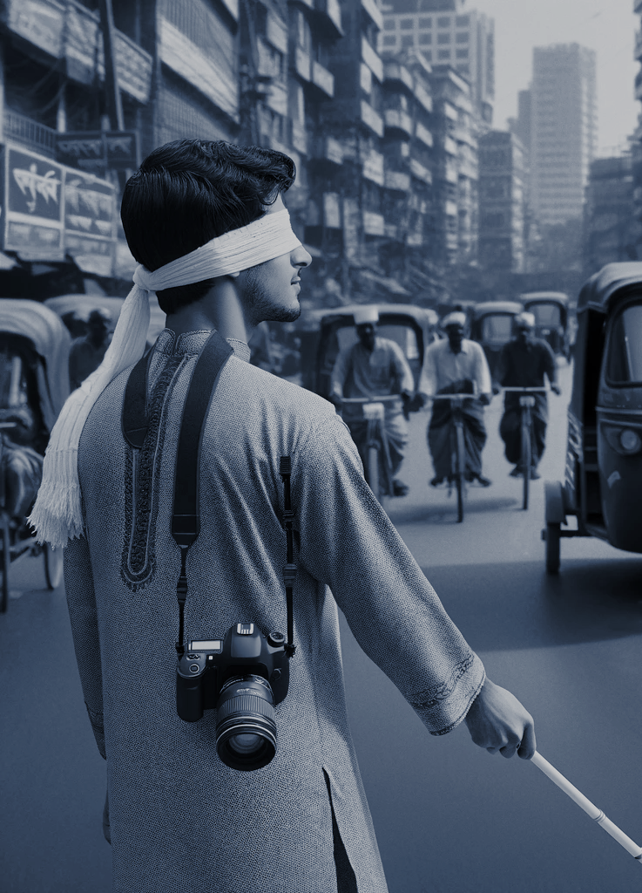
Sound of Silence: Transforming Visuals into Bengali Audio For the Blind
RA: EHSANUR RAHMAN RHYTHM
ST: FARAH BINTA HAQUE
Presented By:
Team 18
Isratul Hasan 20301072
Maliha Mehejabin 20301264 Tahsin Ashrafee Susmit 20301088

Slide 2
Introduction
Tech Approach:
ML for predictions.
Deep learning with neural networks.
Key Models:
CNN-VGG16: Efficient image processing.
RNN-LSTM: Sequential data handling.
Accessibility System:
Integrating CNN-VGG16, RNN-LSTM, and Google TTS.
Converts visual data into verbal descriptions.
Achievements:
39K captioned images compiled.
97.14% combined model accuracy.
Blue scores (1=0.53, 2=0.35) for translation quality.

Slide 3

Literature Review
Text-to-Audio Algorithm:
Proposed by Chowdary et al. (April 2023).
OCR translates 38+ languages, SqueezeNet excels (83.56%).
Bangla Photo Captioning:
Akash et al.'s research (2022).
Uses ResNet50 for feature extraction.
Trained on BanglaLekhaImageCaptions and Flickr datasets.
Novel OCR for Blind Users:
Research by Hemalatha et al. (April 14, 2022).
Introduces an OCR tool for visually impaired users.
Achieves higher accuracy than existing algorithms.
Bengali Image Captioning Model:
Khan et al.'s model (Feb 14, 2021).
Combines CNN and ResNet-50 for linguistic variety.
Outperforms traditional LSTM in sentence structure details.

Slide 4

Data collection
Dataset Selection:
Initiated analysis with Flickr 8k dataset.
Expanded dataset to include Flickr 30k images.
Combined various sources, resulting in 39,100 photos.
Linguistic Diversity:
Each image linked to a minimum of five Bengali subtitles.
Methodical approach for conveying language intricacies.
Data Cleansing:
Rigorous cleansing process to enhance dataset quality.
Eliminated duplicates and irrelevant captions.
Audio Synthesis:
Utilized 'gtts' (Google Text-to-Speech) module.
Converted written explanations into audio for accessibility.

Slide 5
Methodology
1. CNN:
Core for image processing and classification.
Inspired by visual cortex and ImageNet.
Comprises convolutional, pooling, and fully connected layers.
2. LSTM:
Key for NLP sequential data processing.
Excels in contextual information capture.
Gates enhance sentence understanding.
3. VGG-16:
Simonyan and Zisserman's ILSVRC 2014 model.
3x3 filters, max-pooling, fully connected layers.
Top positions in object localization and categorization.
4. Google tts voice
Different languages, genders, and dialects for different listening.
Speech rate and pitch can be customised for different applications.

Slide 6
Result Analysis
Model Comparison:
Analyzed VGG16 and LSTM architectures for accuracy.
Implemented a tokenizer to establish a photo-caption connection.
Training Details:
Batch size: 32, Epochs: 10.
Training duration per epoch: 3789.5 seconds.
Performance Metrics:
Achieved accuracy: 97.1391%, Loss: 2.8609%.
Evaluated performance using BLEU-1 (0.532062) and BLEU-2 (0.353796) scores.
Visual Representations:
Bengali language excels in generating connected visual and textual representations.
See Fig. 6 and Fig. 7 for photos and corresponding predicted textual representations.

Slide 7
Limitations
Accuracy Challenges:
Image captioning in NLP varies with image complexity.
Challenges in crafting captions for intricate or ambiguous scenes.
2. Quality Dependency:
System performance linked to image quality.
Blurry or unclear pictures impact accuracy.
3. User Adoption:
Success depends on user acceptance.
Influenced by personal preferences and tech comfort.
4. Technological Accessibility:
Utility relies on easy tech access.
Requires smartphones and capable devices.
5. R&D Challenges:
Acknowledges inherent research challenges.
Emphasizes the need for improvement.

Slide 8
Future work
1. Advanced Algorithms:
Continuous refinement for precise image descriptions.
2. Multilingual Expansion:
Inclusion of more languages with robust language processing.
3. Real-Time Interaction:
Optimization for instant picture processing, minimizing delays.
4. User-Centric Design:
Incorporation of user feedback and smart design strategies.
5. Wearable Integration:
Seamless connectivity with wearable tech for user convenience.
6. Crowdsourced Descriptions:
Gathering detailed information from the public for diverse visual scenarios.
7. Collaboration with Accessibility Organizations:
Forming partnerships with accessibility groups for broader impact.

Slide 9

THANK YOU

